Slide 1
Computer Organization and Architecture
11th Oct, 2010
Dr. Hammad Afzal

Slide 2
Brief outline of today’s talk
Interrupts
  Details on interrupts will come later, for time being, only implications of interrupts on instruction cycle is examined.

Slide 3
Interrupts
Mechanism by which other modules (e.g. I/O, memory) may interrupt normal sequence of processing.

Slide 4
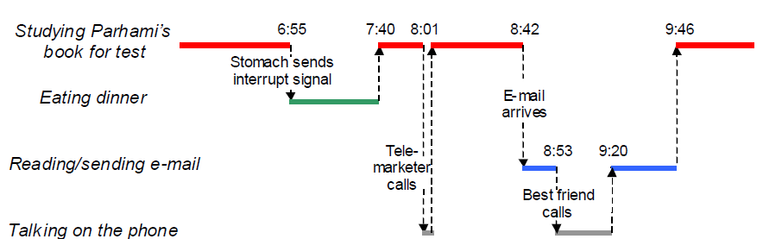
The Notion of Interrupt and Nested Interrupt

Slide 5
Interrupts
Mechanism by which other modules (e.g. I/O, memory) may interrupt normal sequence of processing.
Improves processing efficiency.
  Most external devices are much slower than processor.
  E.g. While transferring data to printer, processor has to pause and remain idle until printer catches up. The length of this pause may be on the order of many hundreds or even thousands of instruction cycles.

Slide 6
Program Flow Control (1)
  Program Control Flow (Next slide): User program performs a series of WRITE calls interleaved with processing.
    Code segments 1,2 and 3 refer to sequences of instructions that do not involve I/O.
    Write Calls are to a program that is system utility and that will perform actual I/O operation.
  Label 4: Preparing actual I/O operation (including copying data to special buffer, preparing the parameters for a device command).
  The actual I/O command
  Label 5: Sequence of instructions to complete the operation (including setting a flag indicating success or failure of operation)

Slide 7
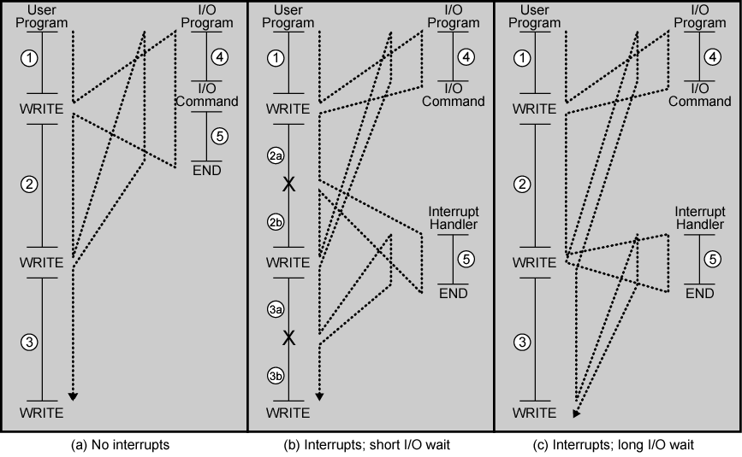
Program Flow Control (2)

Slide 8
Interrupt Cycle (1)
With interrupts, the processor can be engaged in executing other instructions while an I/O operation is in progress.
  In Figure (previous slide), user program reaches to WRITE call.
  The I/O program consists only of preparation of code and actual I/O command.
  After that, control returns to user program. Meanwhile, external device is busy accepting data from memory and printing it.
  Once external device becomes ready to be serviced (ready to accept more data from processor), I/O module for that device sends an interrupt request signal to processor.
  Processor responds by suspending operation of current program, branching off to a program to service that particular I/O device known as interrupt handler

Slide 9
Interrupt Cycle (2)
User program doesn’t have to contain any special code to accommodate interrupts.
Processor and operating system are responsible for suspending the user program and resuming it at same point.
Interrupt Handling Program
  Part of operating system
  Determines the nature of interrupt and performs whatever actions are needed.
    E.g. In previous example, it determines which I/O module generated the interrupt.
    When interrupt handling routine is completed, the processor can resume execution of the user program at point of interruption.

Slide 10
Interrupt Cycle (3)
Added to instruction cycle
Processor checks for interrupt
  Indicated by an interrupt signal
If no interrupt, fetch next instruction
If interrupt pending:
  Suspend execution of current program
  Save context
  Set PC to start address of interrupt handler routine
  Process interrupt
  Restore context and continue interrupted program

Slide 11
Interrupt Cycle (4)
Typically, input or output device sends an interrupt by using a special register, the status or flag register.
A special bit is set to indicate an interrupt has occurred.
  E.g. as soon as input is entered from keyboard, this bit is set.
  CPU checks this bit at start of each instruction cycle.

Slide 12
Interrupt Handling (Additional text)
Upon detecting an interrupt signal, provided the particular
interrupt or interrupt class is not masked, the CPU acknowledges
the interrupt (so that the device can deassert its request signal)
and begins executing an interrupt service routine.
1. Save the CPU state and call the interrupt service routine.
2. Disable all interrupts.
3. Save minimal information about the interrupt on the stack.
4. Enable interrupts (or at least higher priority ones).
5. Identify cause of interrupt and attend to the underlying request.
6. Restore CPU state to what existed before the last interrupt.
7. Return from interrupt service routine.
The capability to handle nested interrupts is important in dealing with
multiple high-speed I/O devices.

Slide 13

Transfer of Control via Interrupts

Slide 14

Instruction Cycle with Interrupts

Slide 15
Instruction Cycle with Interrupts
Extra instructions executed to determine nature of interrupt and decide on the appropriate action (Interrupt handler), nevertheless, efficiency is increased due to difference between speed of processor and I/O devices
Figure (Next Slide) shows gain in the efficiency

Slide 16
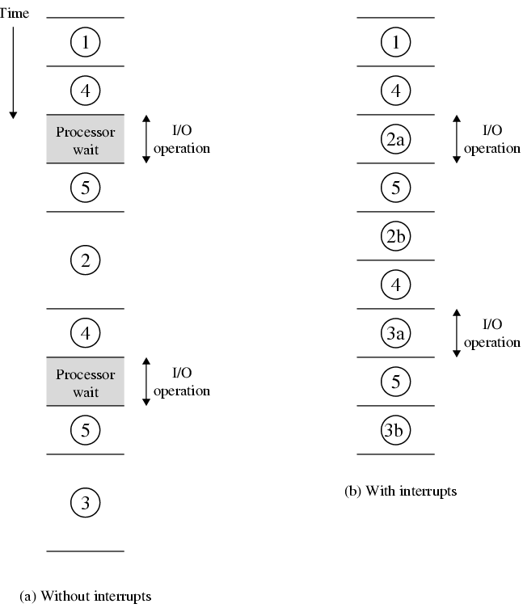
Program Timing Short I/O Wait

Slide 17
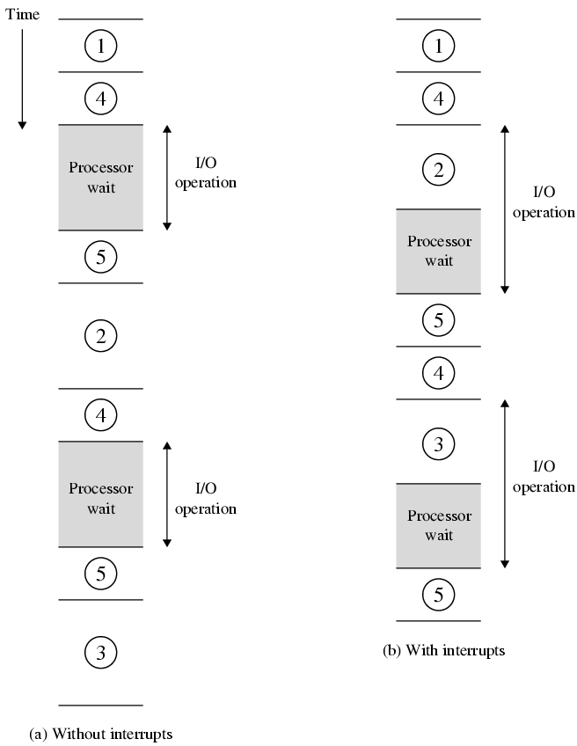
Program Timing Long I/O Wait

Slide 18
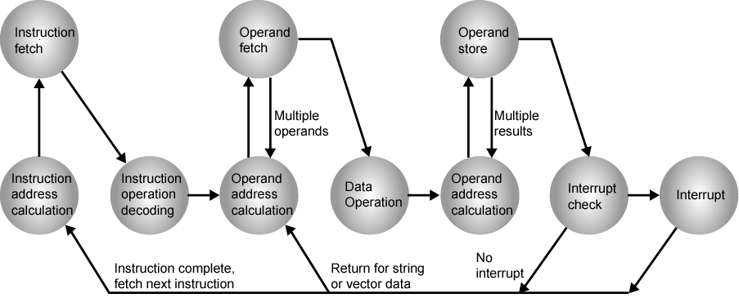
Instruction Cycle (with Interrupts) - State Diagram

Slide 19
Multiple Interrupts
Multiple interrupts can occur, e.g program may be receiving data from communication line and printing results.
  Printer generates interrupt every time it completes print operation.
  Communication line controller generates interrupt every time a unit of data arrives.
  It is possible for communication interrupt to occur while printer interrupt is handled.
Two approaches : Disable Interrupts, define priorities

Slide 20
Multiple Interrupts
Disable interrupts
  Processor will ignore further interrupts whilst processing one interrupt
  Interrupts remain pending and are checked after first interrupt has been processed
  Interrupts handled in sequence as they occur
  Disadvantages: No priority or time critical need
Define priorities
  Low priority interrupts can be interrupted by higher priority interrupts
  When higher priority interrupt has been processed, processor returns to previous interrupt

Slide 21

Multiple Interrupts - Sequential

Slide 22
Multiple Interrupts – Nested

Slide 23

Time Sequence of Multiple Interrupts

Slide 24
Types of Interrupts
Program
  Generated by some condition that occurs as a result of an instruction execution, such as arithmetic overflow, division by zero, attempt to execute and illegal machine instruction, or reference outside a user’s allowed memory space
  e.g. overflow, division by zero
Timer
  Generated by internal processor timer, operating system performs certain functions on regular basis
I/O
  from I/O controller, to signal normal completion of an operation
Hardware failure
  e.g. Power failure, memory parity error

Slide 25
I/O Function
An I/O module can exchange data directly with processor.
  Just like processor can initiate read and write from memory, designating address of a particular location, processor can read/write data to/from I/O module.
  Processor identifies a specific device that is controlled by a particular I/O module.
In some cases, I/O exchanges occur directly with memory.
Processor grants authority to an I/O module to read and write to memory, so that I/O memory transfer can occur without tying up processor. During such transfer, I/O module issues read or write commands to memory, relieving the processor of responsibility for exchange. This is called Direct Memory Access (DMA)

Slide 26
THE END

